Slide 1
Adaptive Weighting Multi-Field-of-View CNN for Semantic Segmentation in Pathology
Kyushu University, Fukuoka, Japan
2019

Slide 2
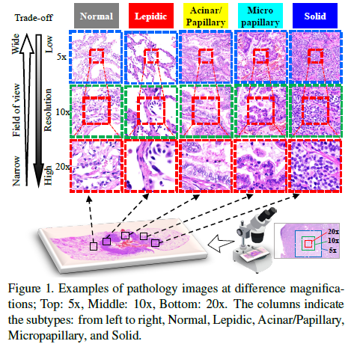
AWMF-CNN
Introduction
Automated digital histopathology
image segmentation
Yoshizawa showed that knowledge
of lung adenocarcinoma subtypes
could be used to predict the prognosis
of a patient who underwent surgical
resection statistically.

Slide 3
AWMF-CNN
Motivation
To make pathological diagnoses,
pathologists usually check images by
changing their magnification in WSI
viewers.
They can check a wide range of
Texture pattern in a low-magnification
Image,whereas they use high-magnify
ication to check details.

Slide 4
AWMF-CNN
Motivation
In this paper, they proposed a novel
Semantic segmentation method, called
Adaptive-Weighting-Multi-Field-of-
View-CNN, that can adaptatively use
image features from images with
different magnifications to segment
multiple cancer subtype regions in the
input image.

Slide 5
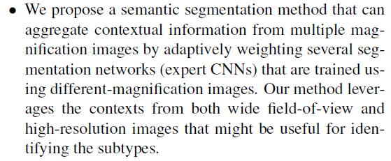
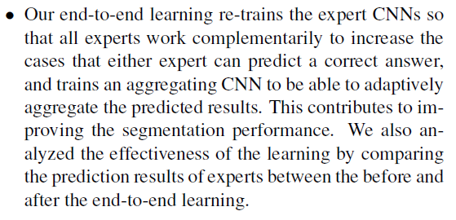
AWMF-CNN
Contribuction

Slide 6
AWMF-CNN
Adaptive Weighting Multi-Field-of-View CNN for Semantic Segmentation in Pathology

Slide 7
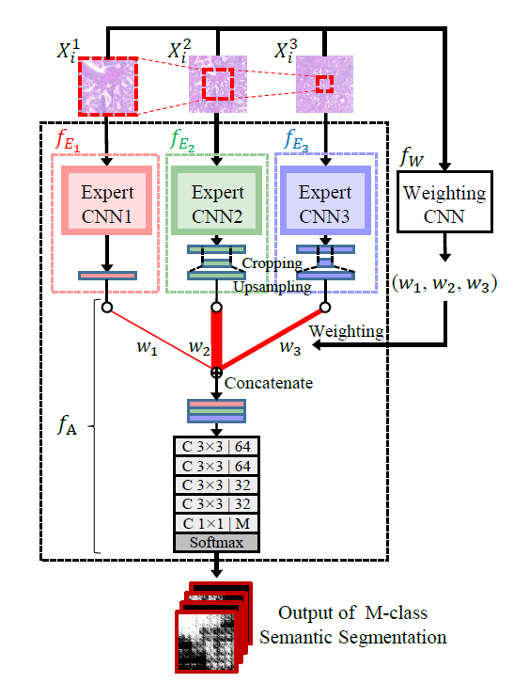
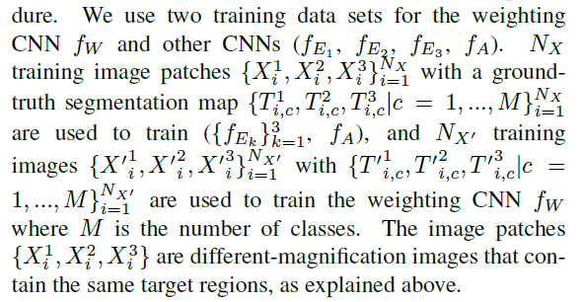

AWMF-CNN
Proposed Method
networks:
$$f_{E_{1}}{,f}_{E_{2}}{,f}_{E_{3}}{,f}_{w}{,f}_{A}$$
training data:

Slide 8
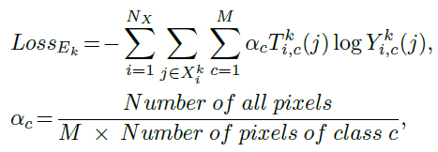
AWMF-CNN
Proposed Method
1，Intialization(Pre-train)

Slide 9
AWMF-CNN
Proposed Method
1，Intialization(Pre-train)

Slide 10

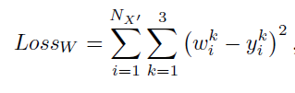
AWMF-CNN
Proposed Method
2，Train Weighting CNN

Slide 11
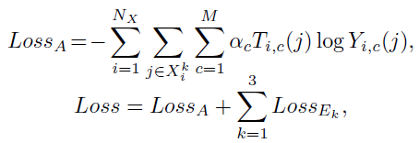
AWMF-CNN
Proposed Method
3，End-to-End Learning of the
intergrated network

Slide 12
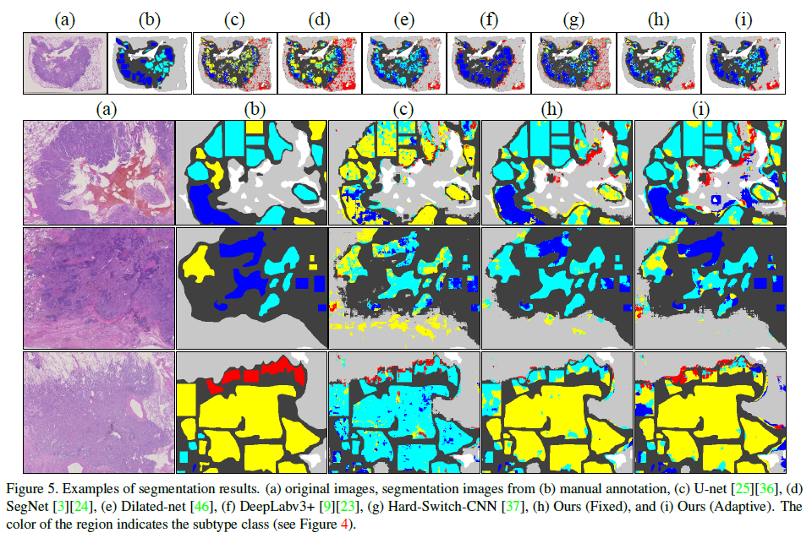
AWMF-CNN
Experimental Result:

Slide 13



AWMF-CNN
Experimental Result:
The overall pixel accuracy：
The mean of the per-class accuracy：
The mean of the intersection over the union：

Slide 14
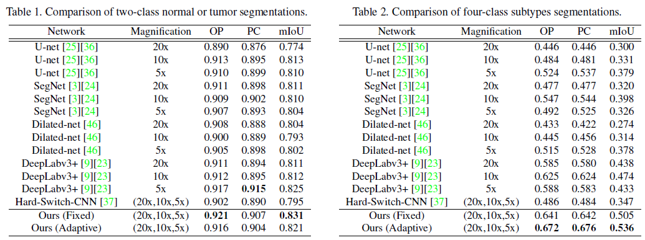
AWMF-CNN
Experimental Result:

Slide 15
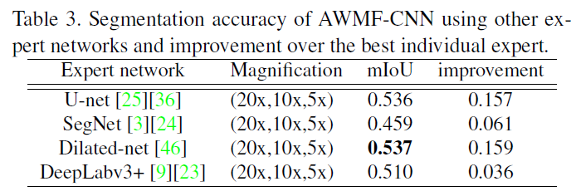
AWMF-CNN
Experimental Result:
Varying expert networks

Slide 16
Thanks

